Slide 1


Aerial Photogrammetry and Modelling of the Calgary Zoo
Team ZooOGL Lynn Cui, Trisha Escorpiso, Tyler Greene, Kristy Guan, Dawood Nadeem, Steven Schroeder

Slide 2
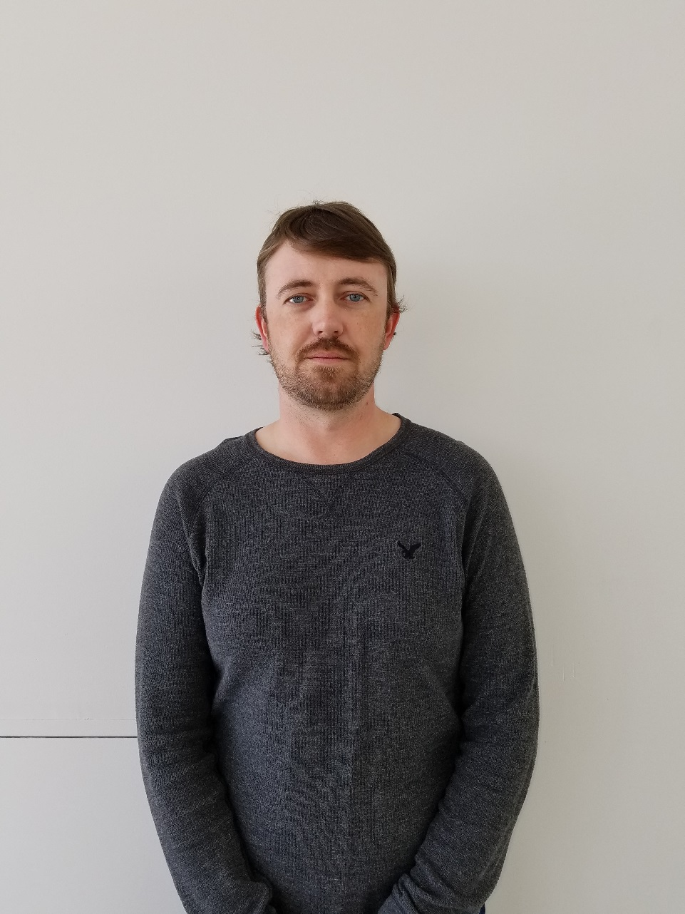
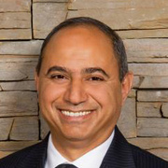
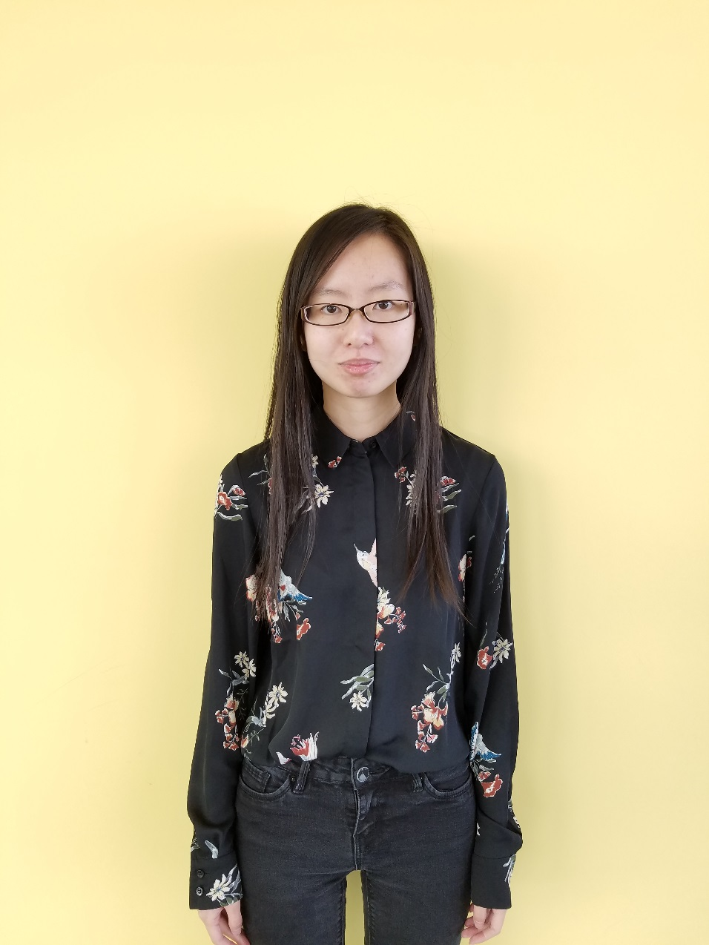
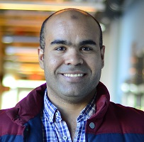
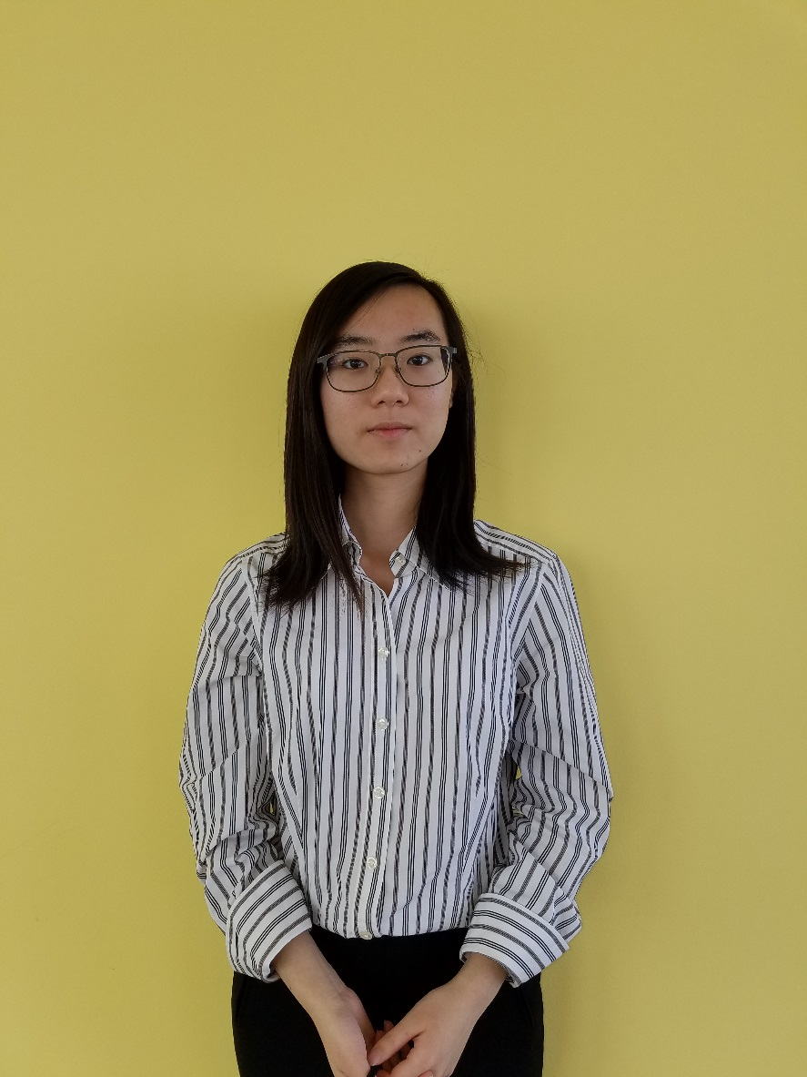
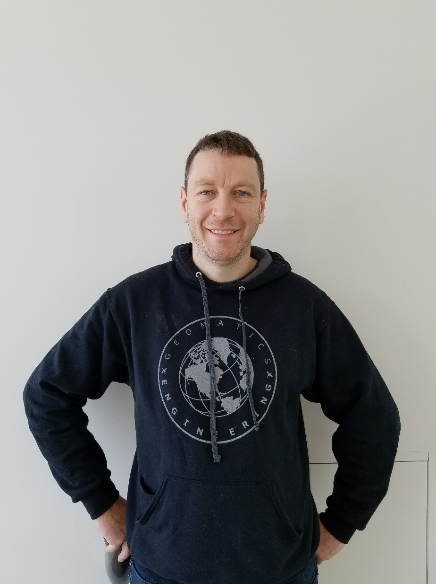
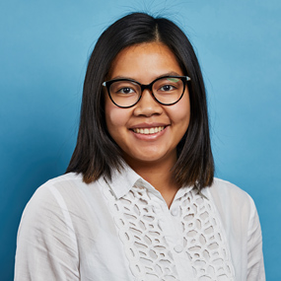
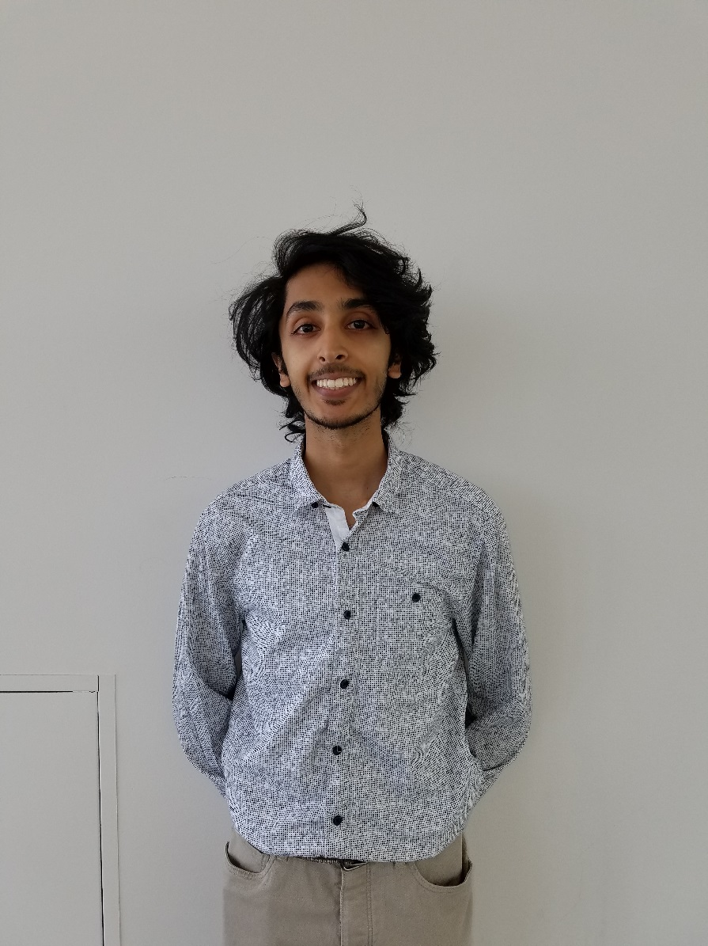
:
Assistant Supervisor:
Hani Mohammed
Tyler Greene
Supervisor:
Dr. Naser El-Sheimy
Kristy Guan
Meet the Team:
ZooOGL
Lingyi Cui
Steven Schroeder
Sponsor:
Trisha Escorpiso
Dawood Nadeem

Slide 3
Overview
Introduction
Project Objectives
Collaborator and User Profile
Project Plan
Sustainability
Budget
Issues and Risks
Benefits
Questions

Slide 4
Introduction
The goal of this project is to create a detailed map and 3D model of the Calgary Zoo.
OGL Engineering will provide the aerial photographs and LiDAR data.

Slide 5
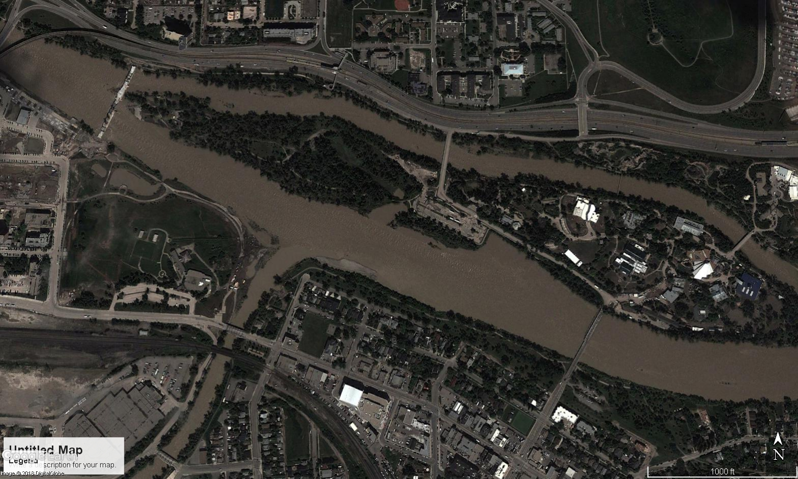
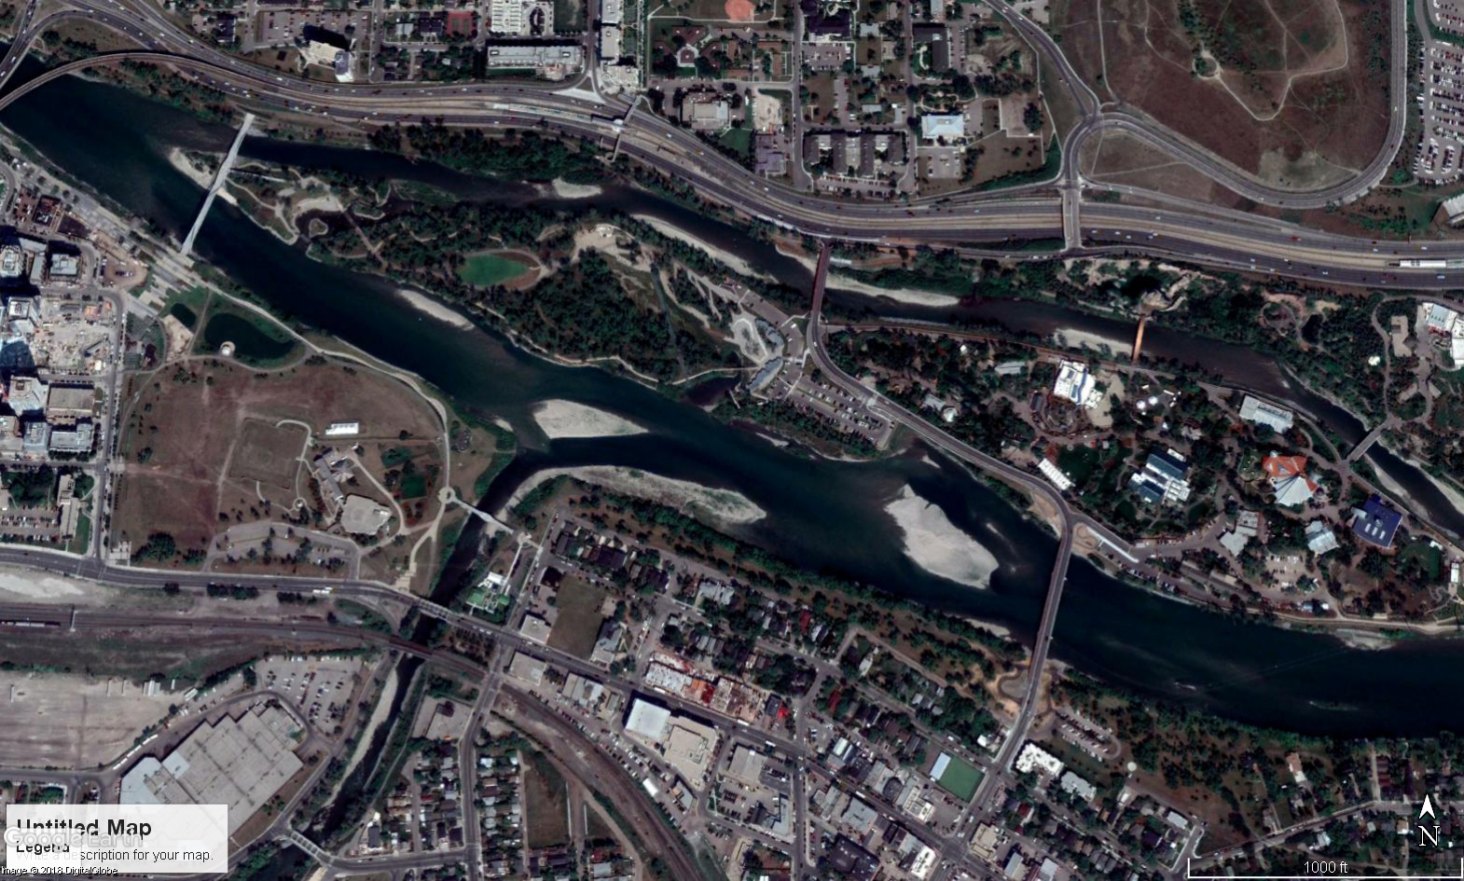

Slide 6
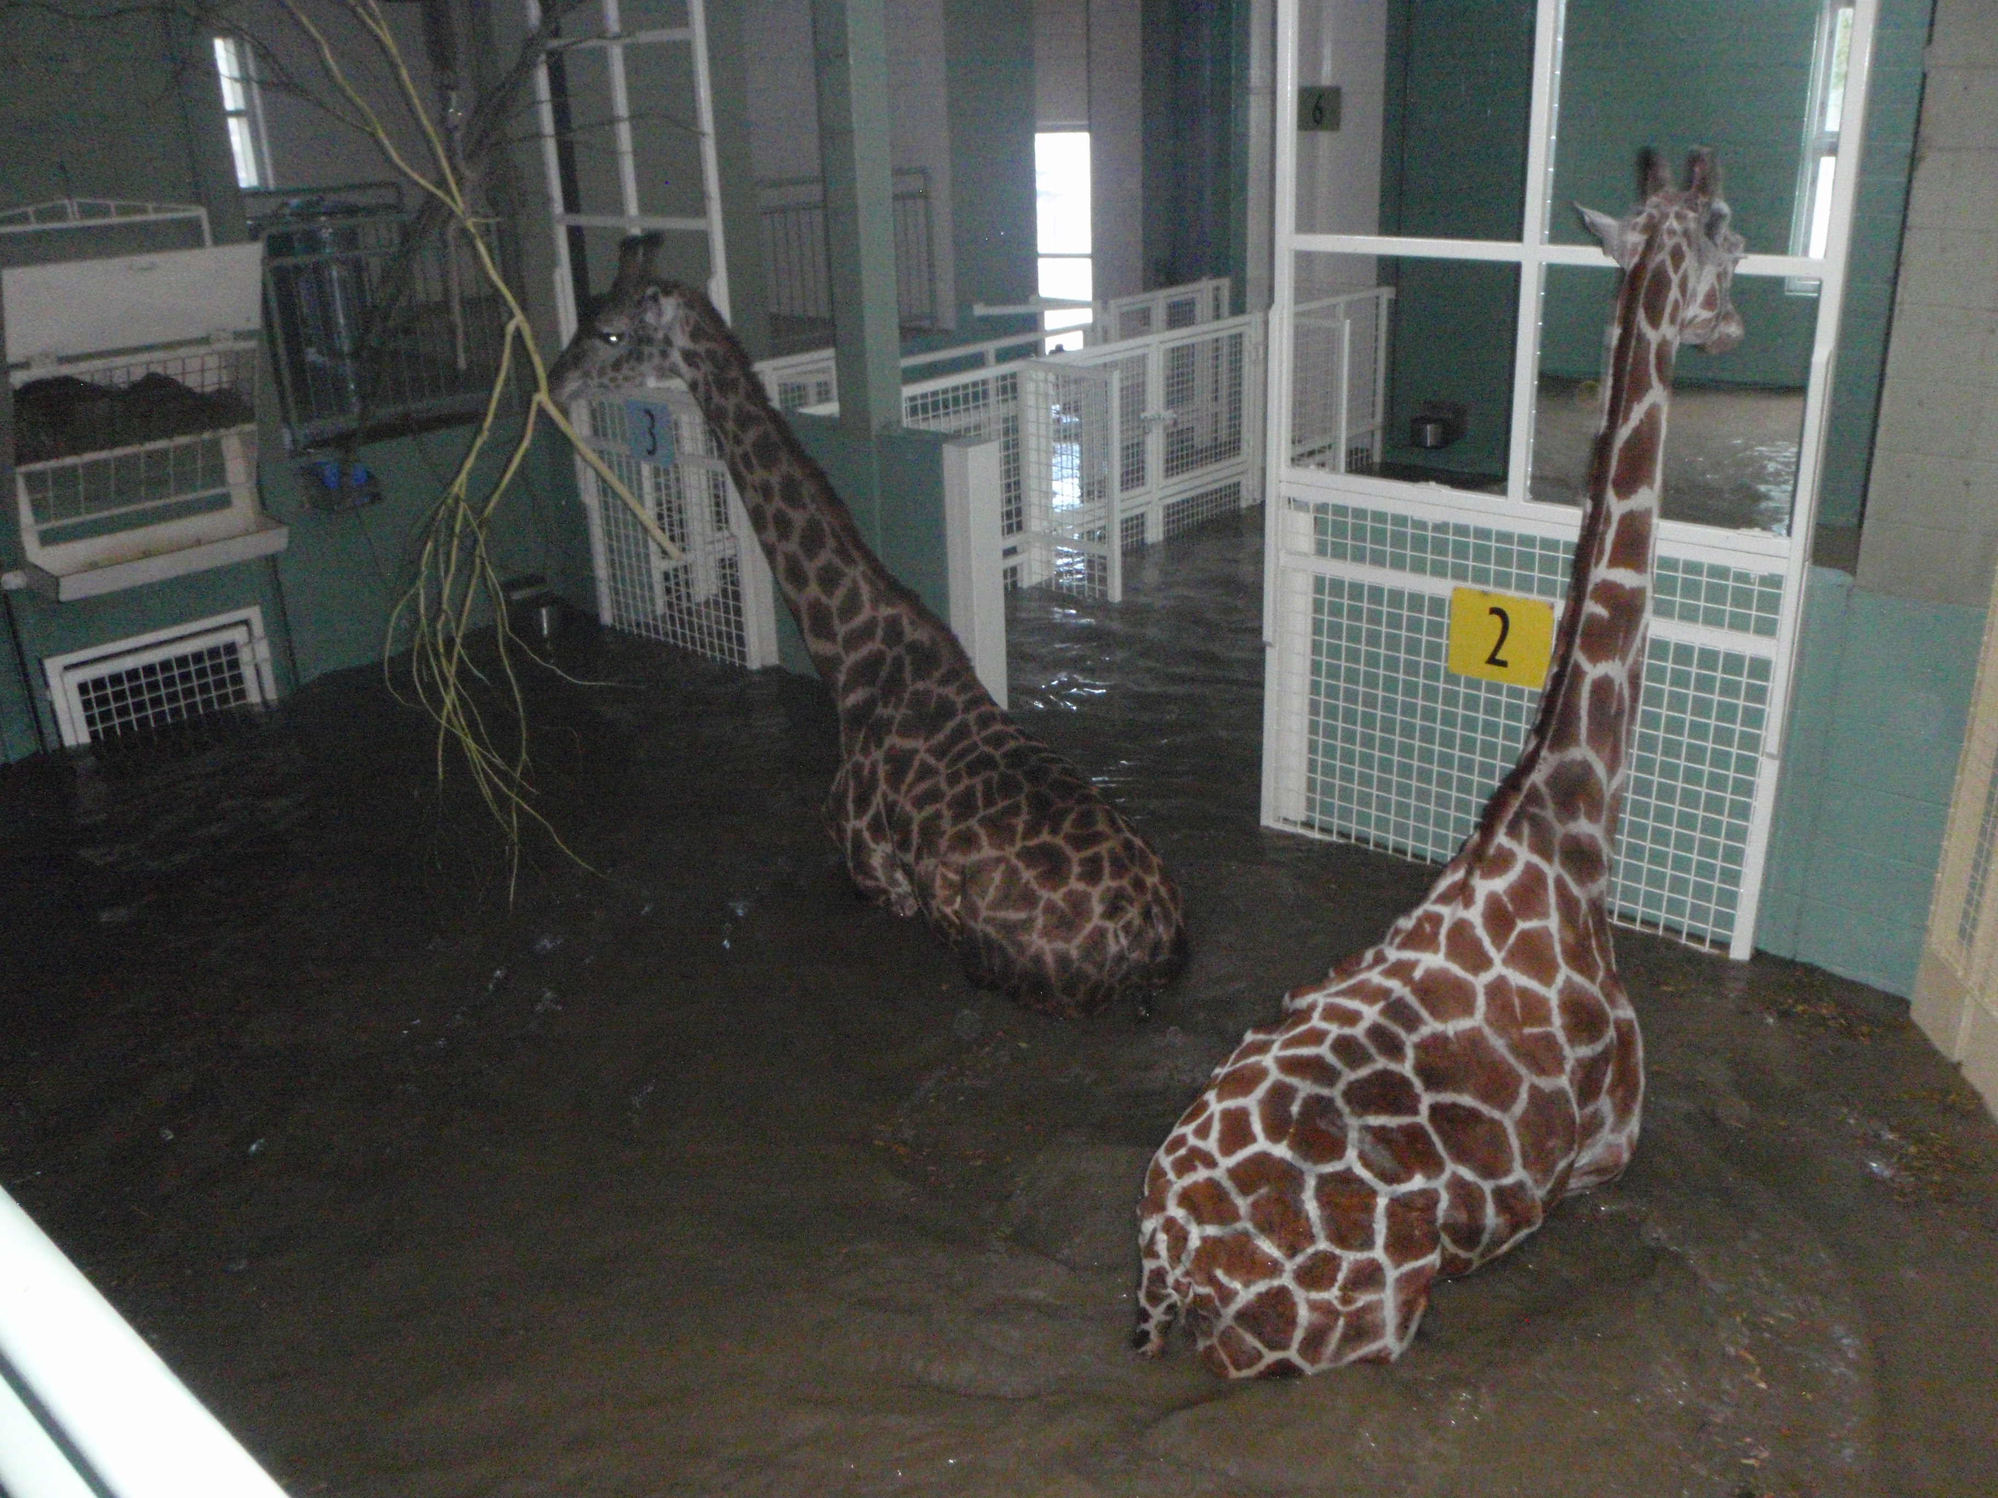
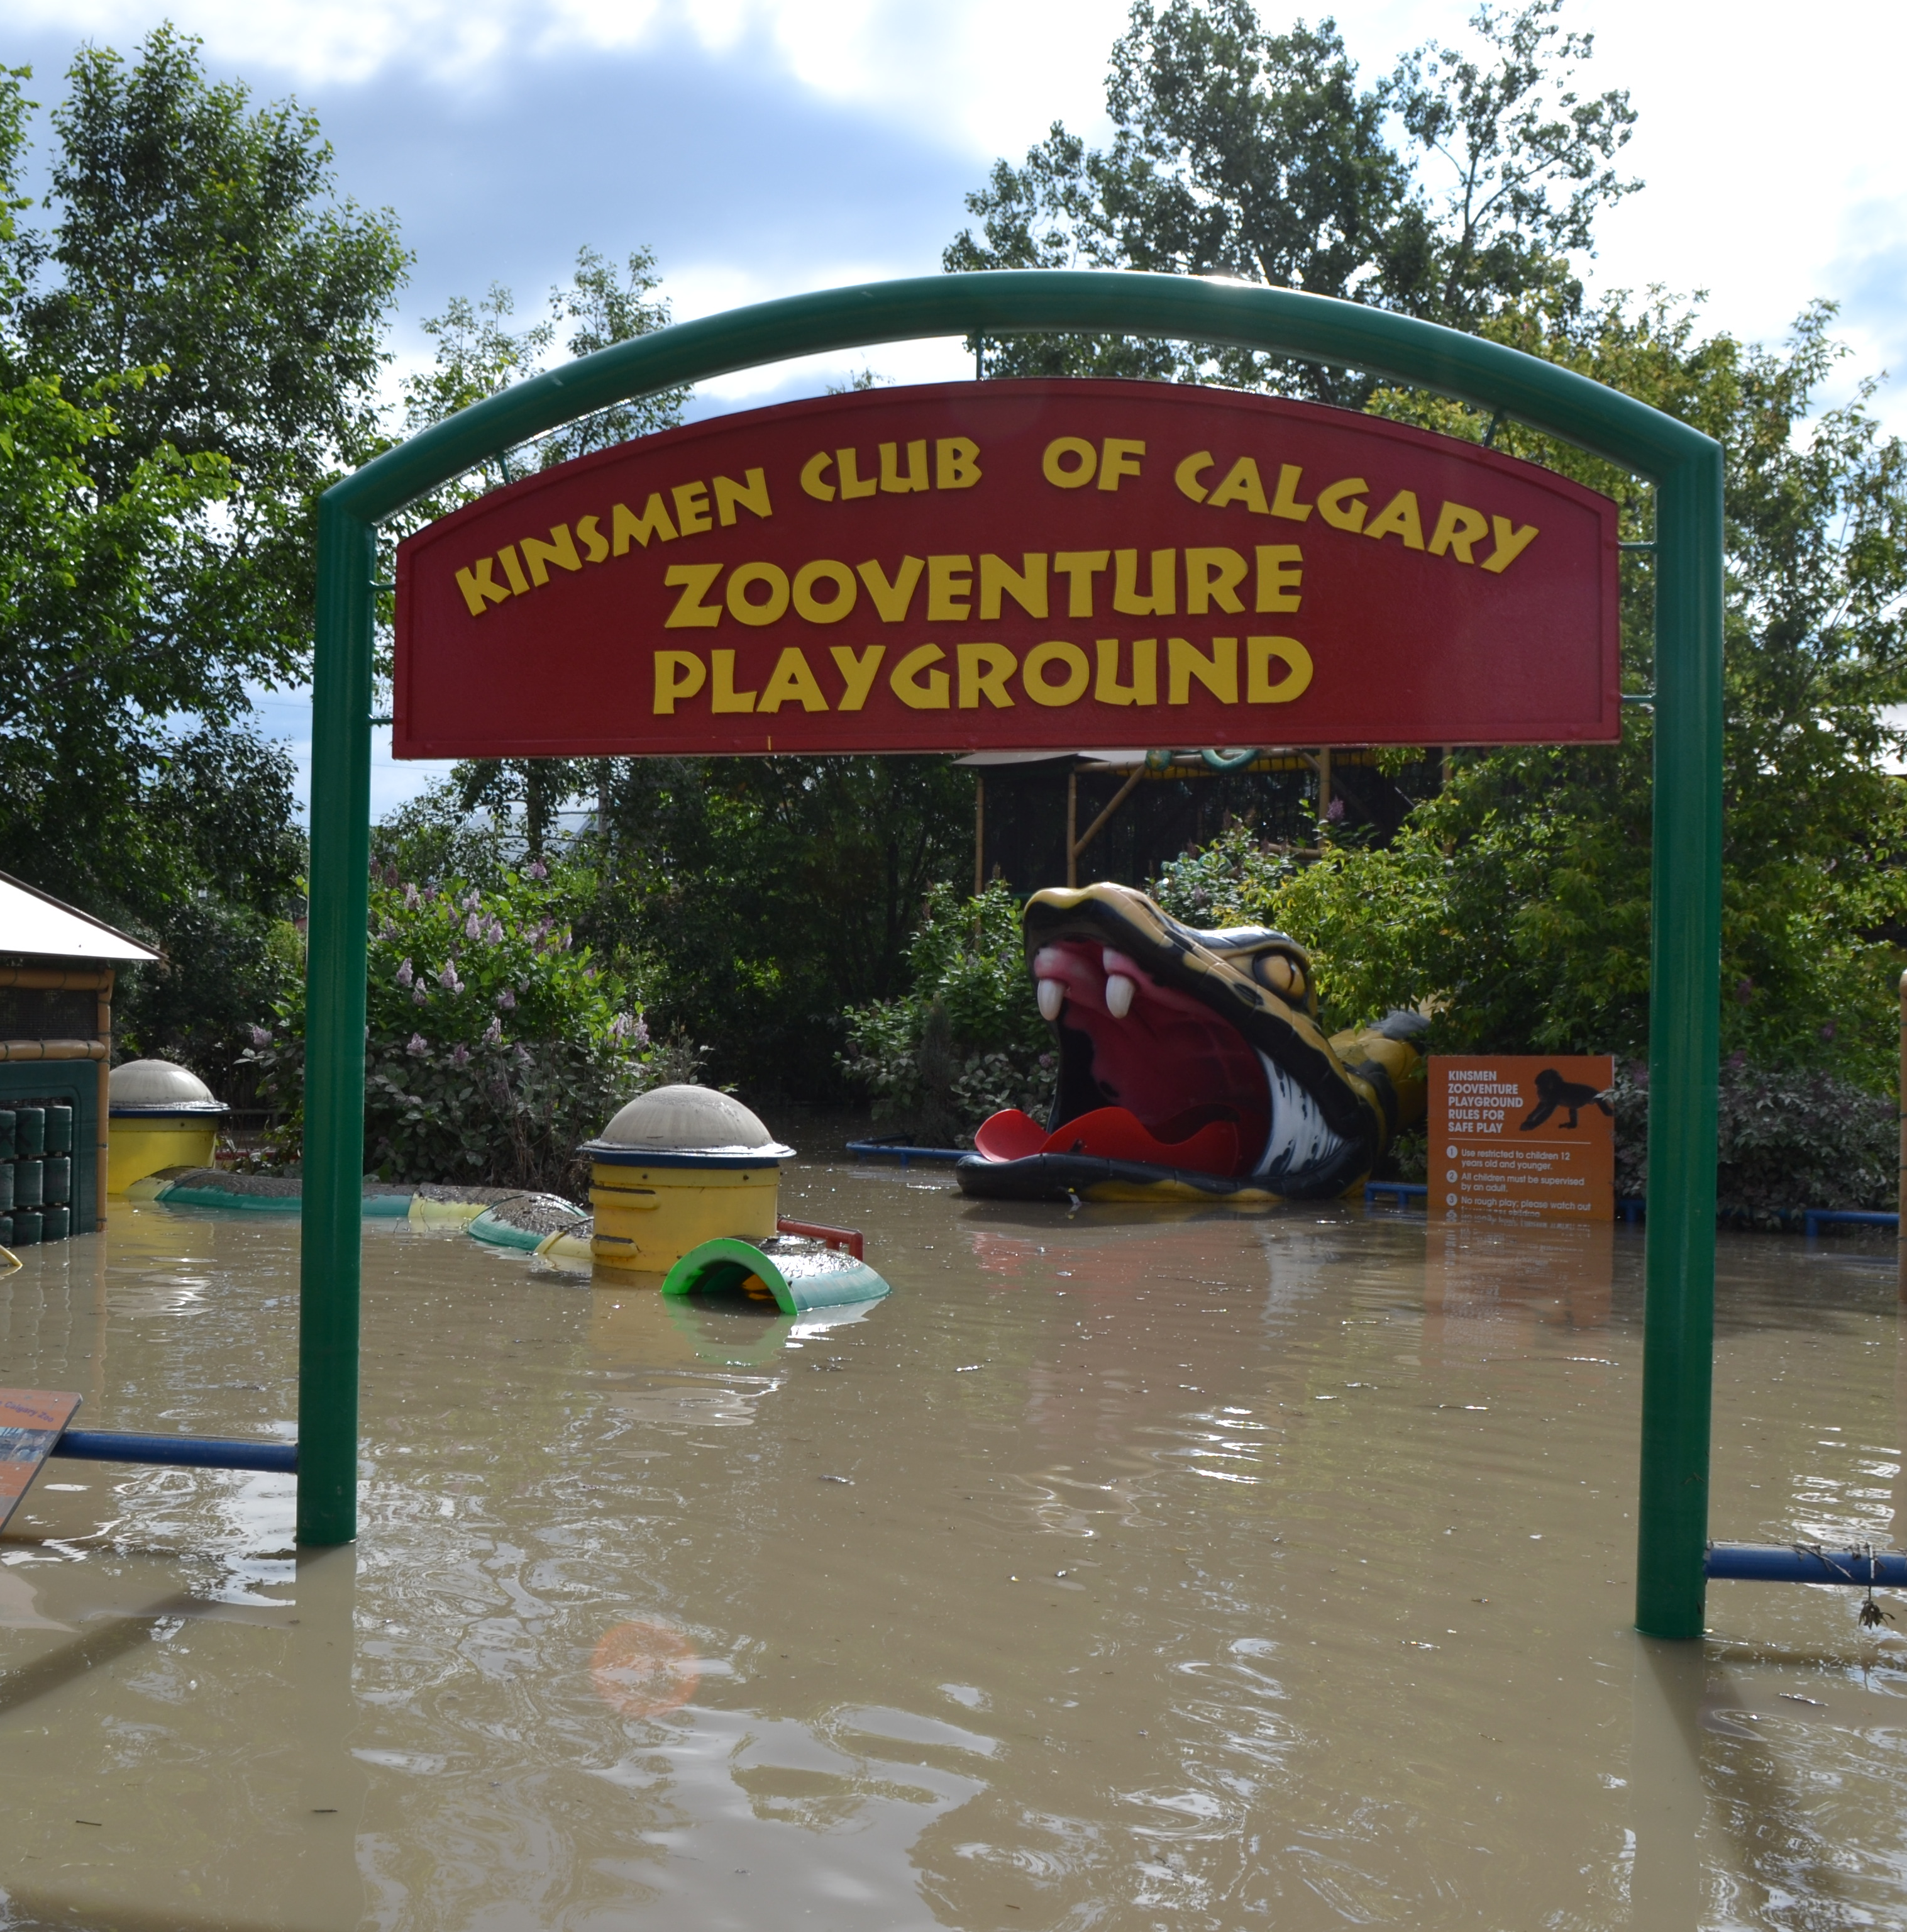
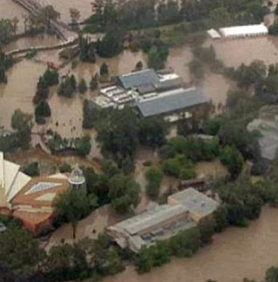
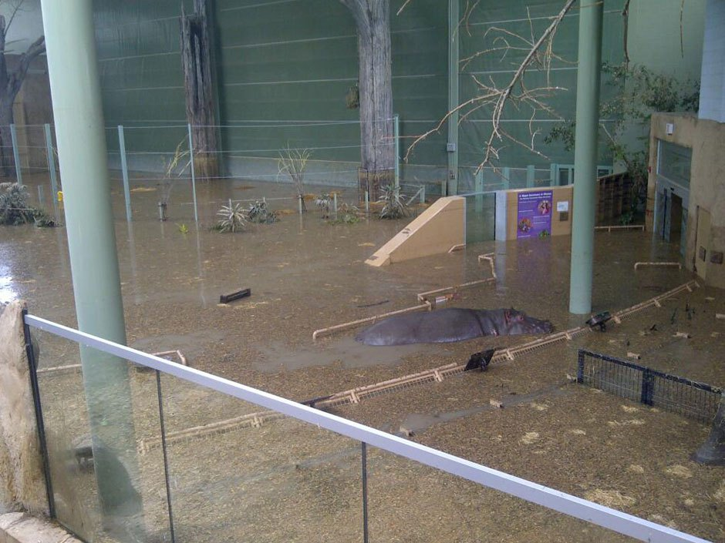
Calgary Flood 2013
They had no ability to quickly and accurately measure how high the water would reach
Less than 10 hours to evacuate over 200 animals
Photo credit: Calgary Zoo & Calgary Herald

Slide 7
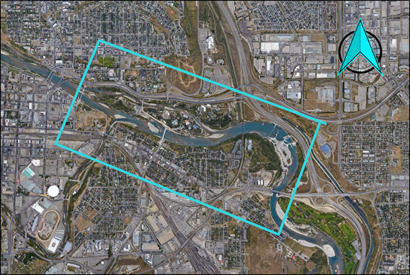
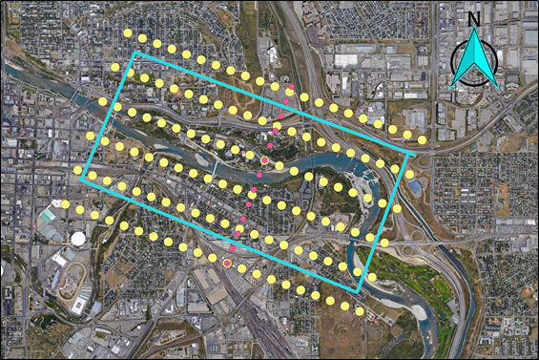
Area of Interest (AOI) and Flight Plan

Slide 8
Project Objectives
Objectives
Design a flight plan to acquire aerial images and LiDAR data of the AOI
Perform template matching
Output
Orthophoto mosaic
Calgary Zoo map with identified ground features
DEM, DSM
3D model of main Calgary Zoo buildings
Outcome
Prediction and mitigation of flooding impacts of the Bow and Elbow rivers
Use network design knowledge to acquire well-distributed GCPs
Generate sparse 3D point cloud

Slide 9
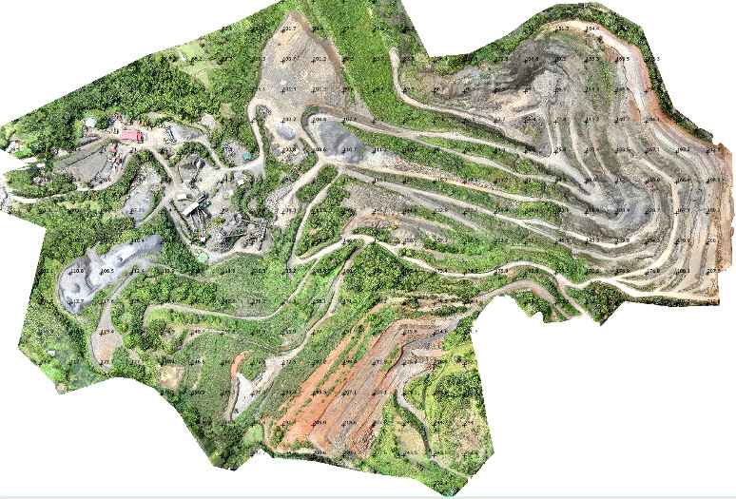
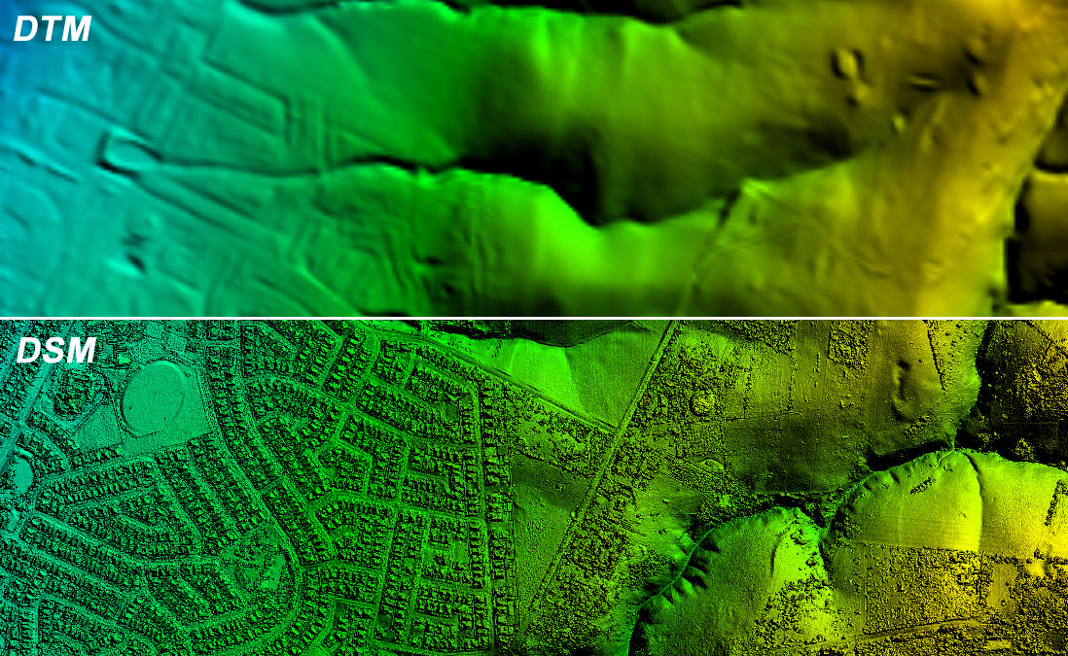
Example of DTM/DEM, DSM, and Orthomosaic
Credit: Integrated Geoscience Limited
Credit: GeoDeSIS

Slide 10
Collaborators and User Profile
OGL Engineering
Sponsor Company
Specializes in collecting high quality spatial data including aerial LiDAR, high resolution ortho-rectified imagery, 3D laser scanning, and bathymetry
Dr. Naser El-Sheimy
Expertise in multi-sensor systems, GPS/INS integration, mobile mapping systems, digital photogrammetry, applications in transportation, GIS
Hani Mohammed
PhD student and researcher under Dr. El-Sheimy
Interests include estimation techniques, GPS/INS integration for navigation, Laser Scanner

Slide 11
Project Plan
Design a flight plan that collects LiDAR data and aerial photos at 5cm GSD
Design a ground control survey network for collecting GCPs
Perform camera self-calibration
Classify LiDAR data
Create DEM and DSM
Create orthophotos and orthophoto mosaic
Create a 2D zoo map with identified ground features
3D models of the main zoo buildings

Slide 12
Sustainability
Used for city planning and land use classification
Aerial images required every few years
Updated DEMs for flood risk management
Reconstruction after flood

Slide 13
Approximate Budget $53,441
Aerial Photography $2,441
Ground Control Survey $13,000
Data Processing $26,000
Project Administration $12,000

Slide 14
Issues and Risks
Fail to meet user requirements/specifications
Bad Weather
Fail to generate accurate and complete DEM and zoo map
Personnel injury during surveying
Availability/loss of qualified personnel
Fail to collect images/LiDAR data or complete survey due to

Slide 15
Benefits to the public and the Zoo
Flood hazard map of the Zoo and Harvey Passage

Slide 16

Questions?
Credit: KeliGirl

